Slide 1
Successful Start-ups
SAY WHAT YOU SEE
IDEA

Slide 2
How business ideas can be successful
In this topic you will learn about:
  How business ideas can be successful
  Importance of meeting customer needs
  Successful entrepreneurs
  Features of successful businesses
  Measures of success

Slide 3
Features of successful business ideas
Feature 1: Find innovative solutions to problems
  What new innovations have been made into successful businesses?
Team activity
  If you could invent a new product to solve a problem what would it be?
  Could this idea be a successful business idea?

Slide 4
What new innovations have been developed into successful businesses? Can you list 3 examples?
E.g. Fraser Doherty - SuperJam

Slide 5


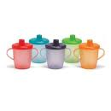
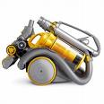
Great British Inventions
Can you name these innovations and their inventors

Slide 6
Great British Inventors
Tim Berners-Lee – the World Wide Web
Trevor Baylis – the Wind-up Radio
James Dyson – the bagless vacuum cleaner
Mandy Haberman – the Anywayupcup
How many failed attempts did Dyson have before creating his working vacuum cleaner?

Slide 7
If you could invent a new product to solve a problem what would it be?
Ideas?

Slide 8
Determination is a key characteristic of entrepreneurs
“Fifteen years and 5,127 prototypes later I had perfected a vacuum cleaner that didn’t lose suction, the Dual Cyclone. It took 15 years of swearing, struggling, creating, being knocked back by several short-sighted companies and inventing to get to this stage today.”
James Dyson

Slide 9

Lesson Objectives:
To understand the term ‘Entrepreneur’
To understand what characteristics an entrepreneur has

Slide 10
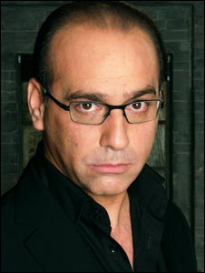



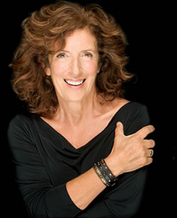
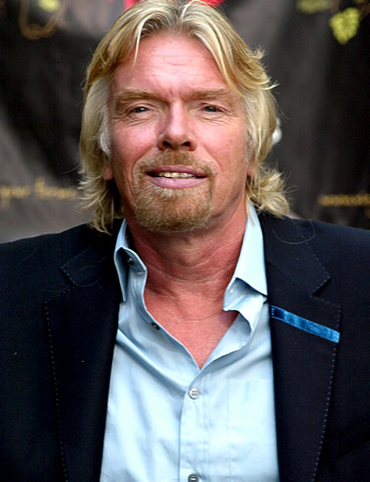

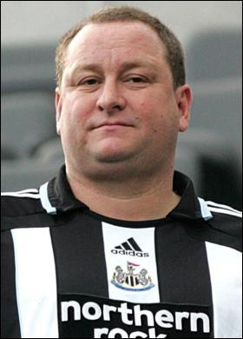


In pairs - Can you match them up?
1
2
A
B
D
3
C
4
E
5

Slide 11

D
4
Richard Branson
Theo Paphitis
A
3
1
Bill Gates
B
Mike Ashley
Anita Roddick
2
E
C
5

Slide 12
What is an entrepreneur?
“A person who organises, operates, and assumes the risk for a business venture”
“A person who takes the risk in starting a new business”
LO1

Slide 13
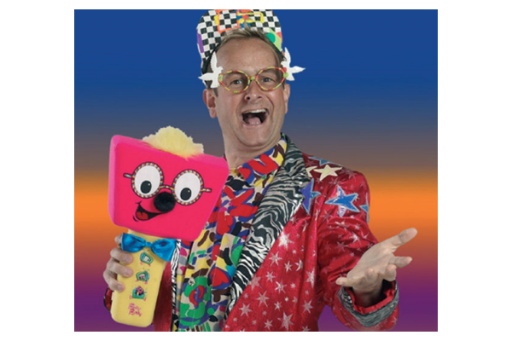
We are going to complete a Mallet’s Mallet of terms to do with Entrepreneurs.
Pupil 1 – Say a word associated with Entrepreneurs
Pupil 2 - Say a word associated with Entrepreneurs
Keep going until you run out of words!!!

Slide 14
What qualities do you think I possess that have helped me along the way?
Richard Branson
Qualities of an Entrepreneur
LO2
Notes:
http://www.online-stopwatch.com/

Slide 15
What qualities do you think I possess that have helped me along the way?
2. Initiative
3. Taking Risks
Determination
Richard Branson
Qualities of an Entrepreneur
4. Decision
Making
8. Luck!
5. Planning
7. Leadership
6. Persuasion
LO2

Slide 16
What entrepreneurial skills do you have?
http://www.mvp.cfee.org/en/selfassessskills.html
Using the above website, please complete the quiz and print your results.

Slide 17
Worksheet
Complete the Match Up Worksheet
Check your answers
Stick in your Book

Slide 18
Task
In pairs you are to produce a 2 to 3 minute presentation on an entrepreneur. Your presentation should include one visual aid and should contain the following information and anything else relevant
      Brief history about the Entrepreneur
      How did the entrepreneur start out?
      What company or companies do they run?
      What are the achievements of the entrepreneur?
      What are the objectives / mission of the entrepreneur and their business?
      How is the entrepreneur coping / reacting to the recession?
      Any other information
This is not a copy and paste exercise from the company website, the presentation must be all in your own words unless you are quoting.

Slide 19
Features of successful business ideas
Can you identify an example to support each of these routes to success?
Feature 2: Meet customer needs
  Products or services
  Filling a gap
  Being better than competitors
Feature 3: Identify new needs
  Responding to changes in society
  Responding to changes in technology
Feature 4: Continue to meet established customer needs
  Continually improving
  Keeping up to date

Slide 20
Features of successful business ideas
Feature 5: Entrepreneurial behaviour
  Thinking of fresh ideas
  Being able to act upon ideas
  Setting up a business
Feature 6: A strong vision
  Being focused and determined
  Turning ideas into actions
Who is your favourite entrepreneur?
Justify your choice.

Slide 21
Features of successful businesses
Feature | Examples
Find innovative solutions
Meet customer needs
Identify new needs
Continue to meet established customer needs
Entrepreneurial behaviour
A strong vision

Slide 22
Local success stories
Local successful business ideas
Draw a spider diagram to show:
Local entrepreneurs
Local successful businesses
In each case identify why they are successful e.g. Innovative solution, meeting needs etc

Slide 23
Measuring success
How can we measure the success of a business?
  Financial criteria
    Sales revenue
    Profit
  Social
    Giving to society
    Supporting a cause
  Customer satisfaction
    Repeat business
    Reviews
    Number of complaints
    Reputation
What is a social entrepreneur?

Slide 24

Thirsty Cat! And Thirsty Dog!
These brands were launched to meet a presumed gap in the market for bottled water for pampered pets
Delicious ‘thirst quenching’ flavours
  Crispy beef
  Tangy fish
Top cat or in the dog house? Vote now
Notes:
Brand failure
“Brand failures” Matt Haig ISBN 0749444339

Slide 25
P3 + M3
Progress Board
You should create a PowerPoint presentation that describes, using relevant examples, the features of a successful business.
    What are the features?
    Why do you think these feature help businesses to succeed?
    Which business with these features have succeeded? (P3)
You should then continue your presentation by comparing the features, strengths and weaknesses of two successful business to show that you are aware of what you must do to succeed.
    Which businesses have you chosen?
    What are their features? Are they similar or different and why?
    What are their strengths? Are they similar or different and why?
    What are their weaknesses? Are they similar or different and why? (M3)

Slide 26
Click me...
Open up P3 PowerPoint on the Shared area.
HERE...

